Slide 1

Algoritma Pemrograman Dasar :
Javascript
2
Day 3

Slide 2
1
Data Type
2
Arithemic Operators
Outline Class
3
Logical and Comparison Operators
42
Assignment Operators

Slide 3
Data Type
Data types are the types of data that we can store in variables.
Javascript is a language that has dynamic typing, meaning that we don't have to write data types when creating variables, such as in C, C ++, Java, etc. which is static typing.
There are several data types in Javascript programming:
String (text)
Number
Boolean
Object
Array
Null
Undefined

Slide 4
A variable in JavaScript can contain any data.
A variable can at one moment be a string and at another be a number:

Slide 5
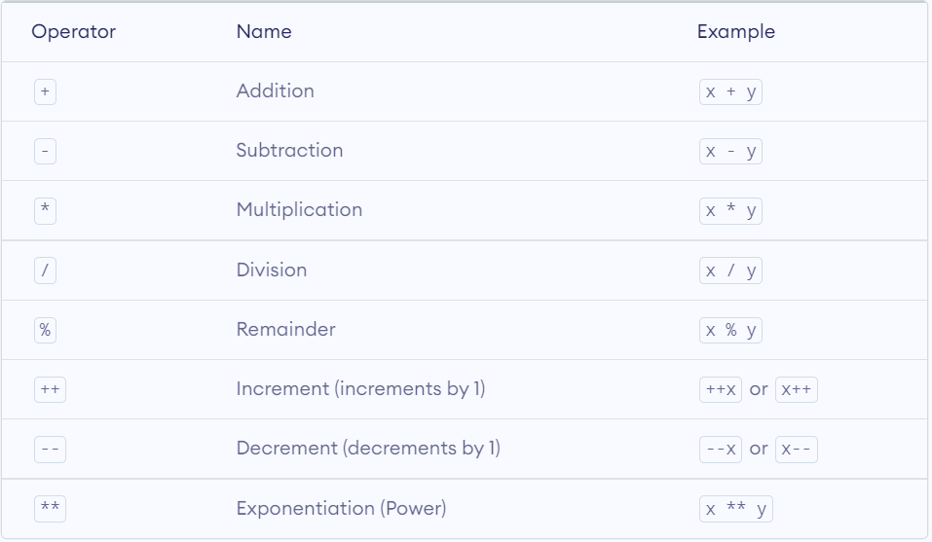
Arithmetic Operators

Slide 6
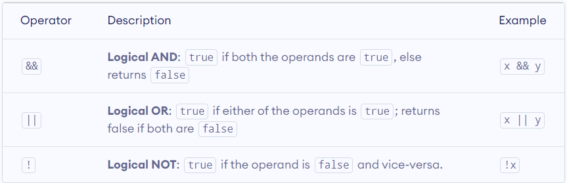
Logical Operators

Slide 7
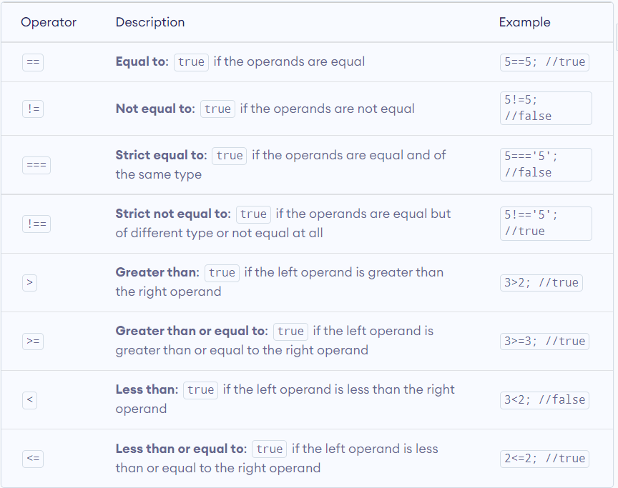
Comparison Operators

Slide 8
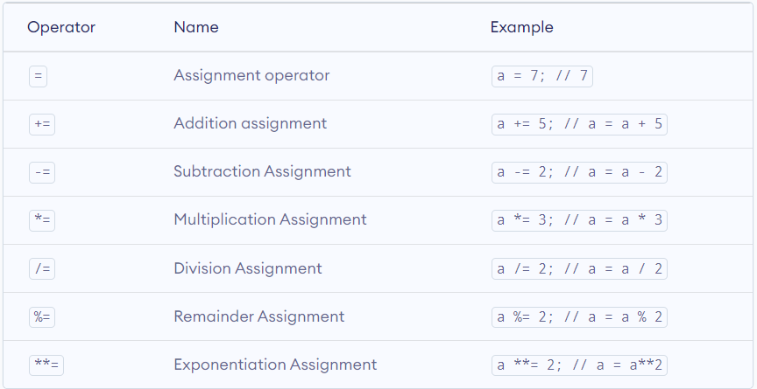
Assignment Operators

Slide 9
Thank you

